Slide 1
MER311: Advanced Strength of Materials
LECTURE OUTLINE
Stress Tensor
Equilibrium
Stress Transformations
Principal Stress
Mohr’s Circle For Stress

Slide 2
Stress at a Point Shown in the Tensile (+) Direction
y
y
σ_{y}
τ_{yz}
τ_{yx}
τ_{zy}
τ_{xy}
τ_{xy}
τ_{yx}
σ_{z}
σ_{x}
σ_{z}
τ_{yx}
τ_{xz}
σ_{x}
τ_{xz}
τ_{zy}
z
x
z
τ_{yx}
τ_{yz}
x
σ_{y}
Surfaces with a Positive
Directed Area Normal
Surfaces with a Negative
Directed Area Normal

Slide 3
Stress Tensor

Slide 4
Element with Finite Dimensions
y
σ_{x}
τ_{xz}
τ_{zx}
σ_{z}
Δy
τ_{xy}
τ_{zy}
x
z
τ_{yx}
τ_{yz}
σ_{y}
Δx
Δz

Slide 5
Equilibrium Equations Sum of the Forces

Slide 6
Equilibrium Equations Sum of the Moments

Slide 7
Stress Tensor

Slide 8
Transforming Stress in Three Dimensions
y
y
θ_{x’y}
x’
A_{z}
x’
y’
y’
A_{x}
τ_{x’y’}
σ_{z}
σ_{x’}
θ_{x’x}
τ_{zx}
σ_{x}
τ_{xz}
τ_{zy}
τ_{xy}
τ_{yz}
x
x
τ_{yx}
A is the area
of the inclined
surface
σ_{y}
A_{y}
τ_{x’z’}
θ_{x’z}
z
z
z’
z’

Slide 9
Strain Tensor

Slide 10
Relationship Between Stress and Strain

Slide 11
Stress-Strain Relations

Slide 12
Strain-Stress Relations

Slide 13
Matrix Form of Stress-Strain Relations

Slide 14
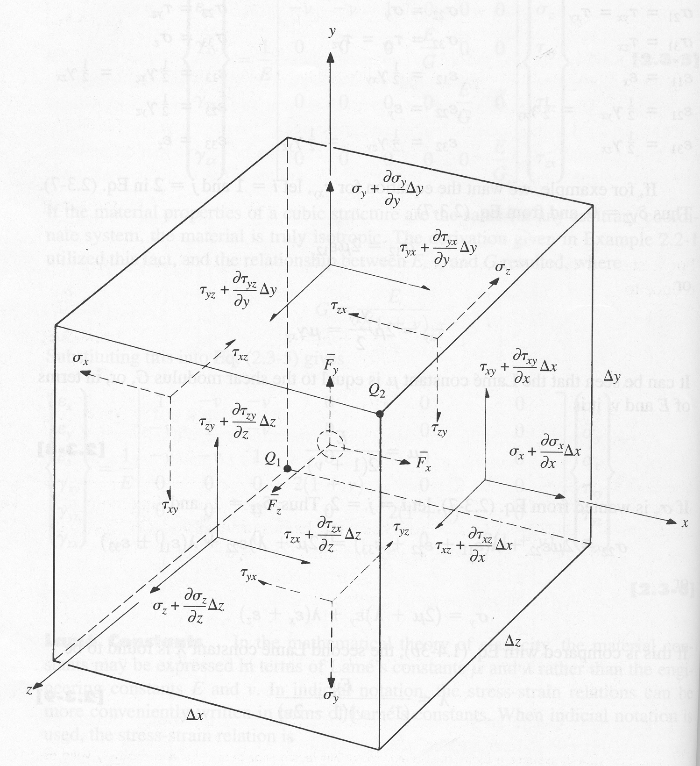
Equilibrium

Slide 15
Example
The stress field within an elastic structural member is expressed as follows:
σ_{x}=-x³+y², τ_{xy}=5z+2y², τ_{xz}=xz³+x²y
σ_{y}=2x³+.5y², τ_{yz}=0, σ_{z}=4y²-z³
Determine the body force distribution required for equilibrium.

Slide 16
Compatibility

Slide 17
Compatibility Continued

Slide 18
Strain-Stress Relationships Linear Elastic & Isotropic Material

Slide 19
Stress-Strain Relationships Linear Elastic & Isotropic Material

Slide 20
Strain-Displacement Relationships Small Deformation, Linear

Slide 21
Cylindrical Coordinates Strain-Stress Relationships Linear Elastic & Isotropic Material

Slide 22
Stress-Strain Relationships Linear Elastic & Isotropic Material

Slide 23
Cylindrical Coordinates Strain-Displacement Relationships Small Deformation, Linear

